Slide 1

L6 Interrupts
Acknowledgement: some slides taken from Yifeng Zhu’s courseware

Slide 2

Polling vs Interrupt
Suppose you are waiting for an important phone call.
Polling:
You pick up the phone every three seconds to check whether you are getting a call.
Interrupt:
Do whatever you should do and pick up the phone when it rings.
// Polling method
while (1) {
read_button_input;
if (pushed)
exit;
}
turn_on_LED;
// Interrupt method
interrupt_handler(){
turn_on_LED;
exit;
}
Notes:
{{Pause=2}} There are two ways to monitor the logic state of an input pin, which is attached to a push button. One is polling, and the other is interrupt. The polling method is like picking up your phone every few seconds, to check whether you are getting a call. The interrupt method is like waiting for the phone to ring. Apparently, the interrupt method is more efficient. You are free to do whatever you should do, and pick up the phone, only when it rings.
{{Pause=1}} Here is a simplified pseudocode of the polling method. In the while loop, software constantly reads the input of {{Pause=0.1}} the pin attached to the push button. It won’t exit the loop until the button is pressed. After the program exits from the while loop, it turns on the LED. The polling method is a busy waiting approach, in which the processor repeatedly reads the input until the button is pressed. It is easy to see, the polling method is simple but inefficient.
{{Pause=1}} The interrupt approach is much more efficient than polling. If the user presses the button, an electrical signal, called interrupt request, is generated. When the processor receives the interrupt request, it automatically suspends the execution of the regular program, and starts the execution of a special defined function called interrupt handler. {{Pause=0.5}} After the interrupt handler completes, the processor restarts the execution of the regular program from where it was stopped. {{Pause=0.5}} Why do we call it an interrupt? {{Pause=0.5}} Because the execution of the regular program is suspended, and the processor is forced to take care of an interrupt request. {{Pause=0.5}} This video explains how interrupts work.

Slide 3
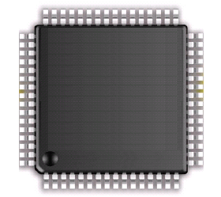
Interrupt Vector Table
Address of ISR 1
ISR Vector Table
Interrupt Number (8 bits) | Memory Address of ISR (32 bits)
1 | ISR for interrupt 1
2 | ISR for interrupt 2
3 | ISR for interrupt 3
4 | ISR for interrupt 4
5 | ISR for interrupt 5
… | …
Nested-Vectored Interrupt Controller (NVIC)
PA.3
EXTI3
NVIC
Cortex-M4
EXTI3_IRQHandler
Interrupt Vector Table
When interrupt x is triggered, jump to the ISR for interrupt x. (1 ≤ x ≤ 255)
Notes:
{{Pause=2}} The Nested Vectored Interrupt Controller (NVIC), prioritizes and handles all interrupts. When we press the push button connected to the pin PA 3, the hardware generates an electrical signal, called interrupt request, E X T I 3. When N V I C receives the interrupt request, it forces the processor to jump to, and execute, a special piece of code, called an interrupt service routine, or an interrupt handler. Specifically, the processor will execute the function named E X T I 3 IRQ Handler. {{Pause=1}} The entry points of all interrupt service routines, are stored in a special table. This special table is called an interrupt vector table. The interrupt vector table is stored at a pre-defined area, in the memory. For ARM Cortex processors, the interrupt vector table starts at the memory address 4. By default, the interrupt vector table is mapped to the lowest address of the internal flash memory. However, software can re-map it to a different location, such as internal SRAM.
{{Pause=1}} To understand interrupts, the concept of interrupt vector table is very important. The interrupt vector table holds an array of memory addresses. Each entry in the interrupt vector table is four bytes long. Each entry contains the starting memory address of an interrupt service routine. To put it simply, the interrupt vector table holds an array of function pointers.
{{Pause=2}} Every type of interrupt is assigned a number, called interrupt number. The interrupt number is used to index into the interrupt vector table. When interrupt x is triggered, N V I C uses the interrupt number x, as the index value, to look up the interrupt vector table, finds the memory address of the corresponding interrupt service routine for interrupt x, and forces the processor to jump to and execute this interrupt service routine.

Slide 4
Interrupts and Exceptions
Asynchronous (peripheral interrupts)
Triggered by external I/O devices
Mouse clicks, keyboard presses, incoming data packets on the network card…
Each interrupt triggers an Interrupt Handler, or Interrupt Service Routine (ISR)
Synchronous (system exceptions)
Triggered by instruction execution
Processor-detected exceptions:
Faults — correctable; offending instruction is retried
Traps — often for debugging; instruction is not retried
Aborts — major error (hardware failure)
Programmed exceptions:
System calls to the OS kernel
Each exception triggers an Exception Handler
In practice, the terms exception and interrupt, Exception Handler , Interrupt Handler and Interrupt Service Routine (ISR) are often used interchangeably.
Notes:
For brevity, we use the term Interrupt Service Routine (ISR) to refer to either Interrupt Handler or Exception Handler in this class

Slide 5
ISR Vector Table
Start address for each ISR for each exception/interrupt type is defined in the ISR Vector Table.
Upon each exception/interrupt, processor jumps to the corresponding ISR by loading PC with its instruction address stored in the table.
Address | Priority | Type of priority | Acronym | Description
0x0000_0000 | - | - | - | Stack Pointer
0x0000_0004 | -3 | fixed | Reset | Reset Vector
0x0000_0008 | -2 | fixed | NMI_Handler | Non maskable interrupt. The RCC Clock Security System (CSS) is linked to the NMI vector.
0x0000_000C | -1 | fixed | HardFault_Handler | All class of fault
0x0000_0010 | 0 | settable | MemManage_Handler | Memory management
0x0000_0014 | 1 | settable | BusFault_Handler | Pre-fetch fault, memory access fault
0x0000_0018 | 2 | settable | UsageFault_Handler | Undefined instruction or illegal state
0x0000_001C-0x0000_002B | - | - | - | Reserved
0x0000_002C | 3 | settable | SVC_Handler | System service call via SWI instruction
0x0000_0030 | 4 | settable | DebugMon_Handler | Debug Monitor
0x0000_0034 | - | - | - | Reserved
0x0000_0038 | 5 | settable | PendSV_Handler | Pendable request for system service
0x0000_003C | 6 | settable | SysTick_Handler | System tick timer
…
Notes:
Exception Vector Table starts at memory address 0
Program Counter pc = 0x00000004 initially

Slide 6
ISR Vector Table

Slide 7
Stacking & Unstacking
Old SP
SP + 0x20 | xxxxxxxx
SP + 0x1C | xPSP
SP + 0x18 | PC (r15)
SP + 0x14 | LR (r14)
SP + 0x10 | r12
SP + 0x0C | r3
SP + 0x08 | r2
SP + 0x04 | r1
SP + 0x00 | r0
Stacking: The processor automatically pushes these 8 registers into the stack before an ISR starts
Unstacking: The processor automatically pops these eight register out of the stack and restores the 8 registers when an ISR exits.
Full Descending Stack
New SP
Two types of stack pointers
Main SP (MSP): only one main stack system-wide
Process SP (PSP): one process stack per thread

Slide 8
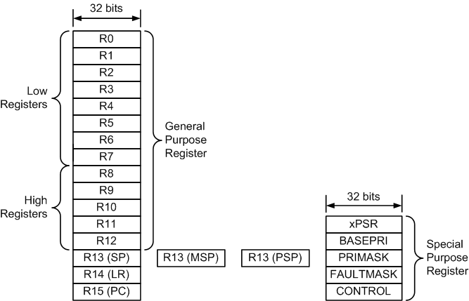
Registers
MSP: Main Stack Pointer
PSP: Process Stack Pointer

Slide 9
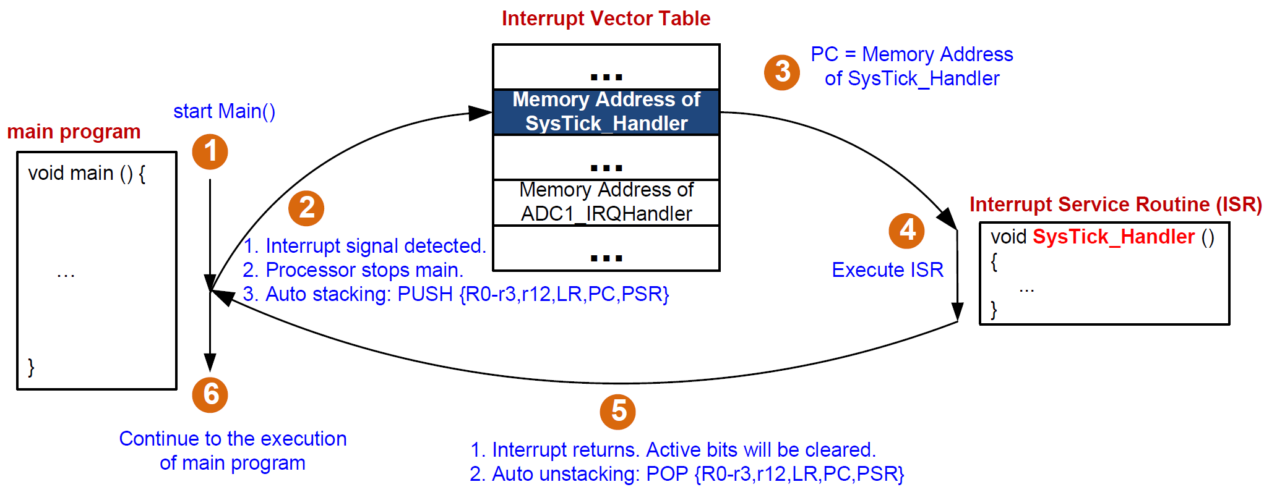
Interrupt

Slide 10
Processor Modes and Privilege Levels
Processor Modes:
Thread Mode: used to execute application or OS software
Handler Mode: used to ISRs triggered by exceptions/interrupts
Privilege Levels:
User Level: cannot use MSR/MRS instructions; cannot access the system timer, NVIC, or system control block; restricted access to memory or peripherals
Application software executes at User Level
Privileged Level: can use all instructions and has access to all resources.
ISR and OS execute at Privileged Level
Controlled by a special 2-bit register CONTROL
Notes:
and cannot use the CPS instruction
The processor modes are:
Thread modeUsed to execute application software. The processor enters Thread mode when it comes out of reset.
Handler modeUsed to handle exceptions. The processor returns to Thread mode when it has finished all exception processing.
The processor returns to Thread mode when it has finished all exception processing.
The privilege levels for software execution are:
The privilege levels for software execution are:
UnprivilegedThe software:
has limited access to the MSR and MRS instructions, and cannot use the CPS instruction
cannot access the system timer, NVIC, or system control block
might have restricted access to memory or peripherals.
Unprivileged software executes at the unprivileged level.
PrivilegedThe software can use all the instructions and has access to all resources.
Privileged software executes at the privileged level.

Slide 11
CONTROL Register
CONTROL[0] controls the access level (Privileged or User)
CONTROL[0]=0 → Privileged Level; CONTROL[0]=1 → User Level
Writable only when executing at Privileged Level.
CONTROL[1] controls the selection of MSP or PSP for stacking/unstacking
CONTROL[1]=0 → use MSP for stacking/unstacking; CONTROL[0]=1 → use PSP for stacking/unstacking
CONTROL[1] is always 0 in Handler Mode; can be either 0 or 1 in Thread Mode.
Writable only in Thread Mode and at Privileged Level.
Operation Modes and Privilege Levels
 | Privileged Level | User Level
Handler Mode (executing Interrupt Handler) | CONTROL[0]=0 CONTROL[1]=0 | N/A
Thread Mode (executing app software or OS) | CONTROL[0]=0 CONTROL[1]=0 or 1 | CONTROL[0]=1 CONTROL[1]=0 or 1
MSP/PSP Selection for Stacking/Unstacking
 | Use MSP | Use PSP
Handler or Thread Mode | CONTROL[1]=0 | CONTROL[1]=1

Slide 12
MSP/PSP Selection for Stacking/Unstacking
Determined by operating mode, and bit 1 of the CONTROL register
Handler mode ⟶ SP = MSP, CONTROL[1] = 0 always
Thread mode ⟶ SP = MSP, if CONTROL[1] = 0
SP = PSP, if CONTROL[1] = 1
In Handler mode, MSP is always used.
In Thread mode, programmer can choose MSP or PSP by setting CONTROL[1], but ARM recommends that application software (User Level) uses the PSP; the OS (Privileged Level) uses the MSP.

Slide 13
Switching of Operation Modes
ISR
Initial/default
Interrupt Exit
Privileged Thread
Interrupt Signal
Interrupt Signal
Interrupt Exit
Set CONTROL[0]=1
User Thread

Slide 14
Switching of Operation Modes: Example
Upon system reset, the CPU starts in Thread mode with Privileged Level (“Privileged Thread”).
Switching of operation modes can be done by setting the CONTROL register or be triggered by exceptions.
An application in Thread Mode, Privileged Level (“Privileged Thread”) can switch into Thread Model, User level (“User Thread”) by setting CONTROL[0]=1.
When an interrupt occurs, the ISR executes in Privileged access level (“Privileged Handler”); upon exiting the ISR, the application thread continues execution in User Level (“User Thread”) by default, or Privileged Level (“Privileged Thread”) by setting CONTROL[0]=0 in ISR.
CONTROL[0] can only be set in Privileged Level, hence an application thread CANNOT directly switch from “User Thread” to “Privileged Thread” by setting CONTROL[0]=0
Notes:
Handler mode and Thread mode
Handler mode always use MSP (Main Stack Pointer)
Thread Mode uses either PSP (Process Stack Pointer) or MSP
Control[1] = 0, SP = MSP (default)
Control[0] = 1, SP = PSP
When the processor is reset, the default is the thread mode.
The processor enters the handler mode when an exception occurs. (e.g., division by 0)

Slide 15
Accessing CONTROL Register
To access the CONTROL register, the MRS and MSR instructions are used:
MRS <reg>, <special_reg> ; Read special register, e.g.
MRS R0, CONTROL ;Read CONTROL register into R0
MSR <special_reg>, <reg> ; write to special register, e.g.,
MOV R0, #0x3
MSR CONTROL, R0 ; Write CONTROL[0]=1; CONTROL[1]=1.
(Cannot directly write #0x3 to special register with MSR)
Think of MRS as “Move Register SpecialRegister”; MSR as “Move SpecialRegister Register”

Slide 16
Which stack to use when exiting an interrupt?
Link Register (LR) has two different usages:
For function calls: LR = address of the instruction immediately after BL, i.e., instruction address to return to after the function call finishes
For interrupts: LR indicates whether MSP or PSP is used for unstacking when exiting an interrupt (return address is stored in the PC, which is pushed on the stack)
LR is initialized to 0xFFFFFFFF upon system reset (reboot)
Upon entering ISR, LR is set to one of 3 EXC_RETURN values
All 3 EXC_RETURN values have bits[31:5] set to 1. When this value is loaded into the PC it indicates to the processor that the ISR is complete, and the processor initiates the appropriate return sequence.
Bits[3:0] of EXC_RETURN indicate the required return stack and processor mode
EXC_RETURN | Bits[3:2] | Return to | Unstack from
0xFFFFFFF1 | 00 | Handler Mode | MSP
0xFFFFFFF9 | 01 | Thread Mode | MSP
0xFFFFFFFD | 11 | Thread Mode | PSP
Notes:
LR value generated by processor
All EXC_RETURN values have bits[31:5] set to one. When this value is loaded into the PC it indicates to the processor that the exception is complete, and the processor initiates the appropriate exception return sequence. Bit 3 of EXC_RETURN determines return mode:
0: return to Handler Mode;1: return to Thread Mode
Bit 2 of EXC_RETURN determines stack for unstacking
0: unstack from MSP; 1: unstack from PSP

Slide 17
Stacking & Unstacking
CONTROL[1] = 0 ⟹ User program uses MSP;
LR is set to 0xFFFFFFF9 upon interrupt signal ⟹ unstacking from MSP upon interrupt exit.
If ISR calls PUSH or POP, the MSP is used.
ISR Exit
ISR
Interrupt
Signal
Unstacking
from MSP
Stacking
onto MSP
Time
Thread Mode
Handler Mode
Thread Mode
MSP
MSP
MSP
EXC_RETURN = 0xFFFFFFF9

Slide 18
Stacking & Unstacking
CONTROL[1] = 1 ⟹ User program uses PSP;
LR is set to 0xFFFFFFFD upon interrupt signal ⟹ unstacking from PSP upon interrupt exit.
If ISR calls PUSH or POP, the MSP is used
ISR Exit
ISR
Interrupt
Signal
Unstacking
from PSP
Stacking
onto PSP
Time
Thread Mode
Handler Mode
Thread Mode
PSP
MSP
PSP
EXC_RETURN = 0xFFFFFFFD

Slide 19
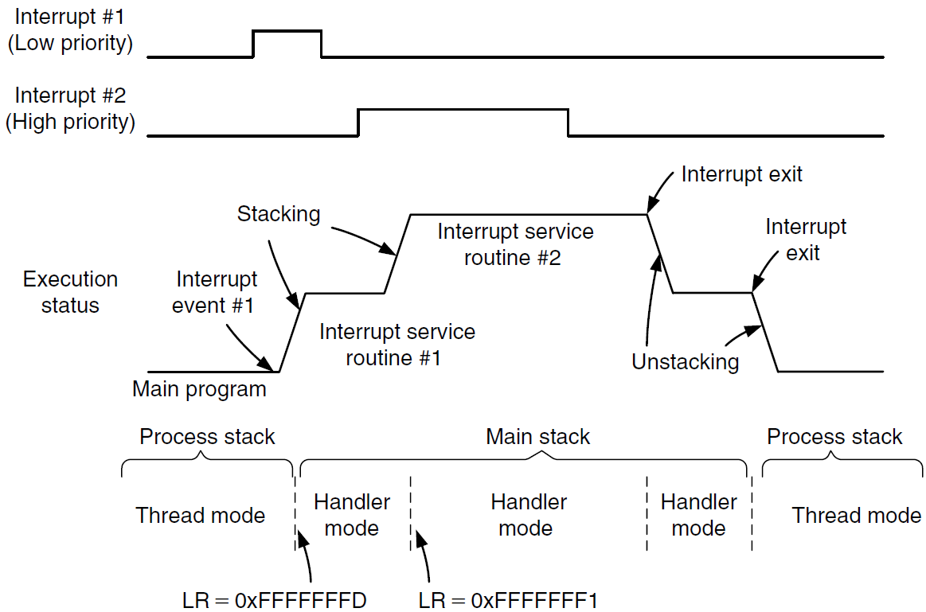
Nested Interrupts
The user program uses MSP
LR is set to 0xFFFFFFF9 when ISR #1 is entered (return to Thread mode upon exit)
LR is set to 0xFFFFFFF1 when nested ISR #2 is entered (return to Handler mode upon exit)
The user program uses PSP; LR is set to 0xFFFFFFFD when ISR #1 is entered; LR is set to 0xFFFFFFF1 when nested ISR #2 is entered (return to handler mode upon exit).

Slide 20
An example to illustrate stacking and unstacking
(assuming MSP is used by the main program)

Slide 21
Interrupt: Stacking & Unstacking
__main PROC
…
MOV r3,#0
…
ENDP
SysTick_Handler PROC
EXPORT SysTick_Handler
ADD r3, #1
ADD r4, #1
BX lr
ENDP
R0
0
xxxxxxxx
0x20000200
addr = 0x08000044
R1
1
0x200001FC
R2
2
0x200001F8
R3
3
0x200001F4
addr = 0x0800001C
R4
4
0x200001F0
R12
12
0x200001EC
R13(SP)
MSP
0x200001E8
R14(LR)
0x08001000
0x200001E4
R15(PC)
0x08000044
0x200001E0
0x200001DC
xPSR
0x21000000
0x200001D8
MSP
0x20000200
0x200001D4
0x200001D0
PSP
0x00000000
0x200001CF
Memory

Slide 22
Interrupt: Stacking & Unstacking
Suppose SysTick interrupt occurs when PC = 0x08000044
__main PROC
…
MOV r3,#0
…
ENDP
SysTick_Handler PROC
EXPORT SysTick_Handler
ADD r3, #1
ADD r4, #1
BX lr
ENDP
R0
0
xxxxxxxx
0x20000200
addr = 0x08000044
R1
1
0x200001FC
R2
2
0x200001F8
R3
3
0x200001F4
addr = 0x0800001C
R4
4
0x200001F0
R12
12
0x200001EC
R13(SP)
MSP
0x200001E8
R14(LR)
0x08001000
0x200001E4
R15(PC)
0x08000044
0x200001E0
0x200001DC
xPSR
0x21000000
0x200001D8
MSP
0x20000200
0x200001D4
0x200001D0
PSP
0x00000000
0x200001CF
Memory

Slide 23
Interrupt: Stacking & Unstacking
STACKING
__main PROC
…
MOV r3,#0
…
ENDP
SysTick_Handler PROC
EXPORT SysTick_Handler
ADD r3, #1
ADD r4, #1
BX lr
ENDP
R0
0
xxxxxxxx
0x20000200
addr = 0x08000044
R1
1
xPSR
0x21000000
0x200001FC
R2
2
PC
0x08000044
0x200001F8
R3
3
LR
0x08001000
0x200001F4
addr = 0x0800001C
R4
4
R12
12
0x200001F0
R12
12
R3
3
0x200001EC
R13(SP)
MSP
R2
2
0x200001E8
R14(LR)
0xFFFFFFF9
R1
1
0x200001E4
R15(PC)
0x0800001C
R0
0
0x200001E0
0x200001DC
xPSR
0x21000000
0x200001D8
MSP
0x200001E0
0x200001D4
0x200001D0
PSP
0x00000000
0x200001CF
Memory

Slide 24
Interrupt: Stacking & Unstacking
STACKING
__main PROC
…
MOV r3,#0
…
ENDP
SysTick_Handler PROC
EXPORT SysTick_Handler
ADD r3, #1
ADD r4, #1
BX lr
ENDP
R0
0
xxxxxxxx
0x20000200
addr = 0x08000044
R1
1
xPSR
0x21000000
0x200001FC
R2
2
PC
0x08000044
0x200001F8
R3
3
LR
0x08001000
0x200001F4
addr = 0x0800001C
R4
4
R12
12
0x200001F0
R12
12
R3
3
0x200001EC
R13(SP)
MSP
R2
2
0x200001E8
R14(LR)
0xFFFFFFF9
R1
1
0x200001E4
R15(PC)
0x0800001C
R0
0
0x200001E0
0x200001DC
xPSR
0x21000000
0x200001D8
MSP
0x200001E0
0x200001D4
LR = 0xFFFFFFF9 to indicate MSP is used.
0x200001D0
PSP
0x00000000
0x200001CF
Memory

Slide 25
Interrupt: Stacking & Unstacking
__main PROC
…
MOV r3,#0
…
ENDP
SysTick_Handler PROC
EXPORT SysTick_Handler
ADD r3, #1
ADD r4, #1
BX lr
ENDP
R0
0
xxxxxxxx
0x20000200
addr = 0x08000044
R1
1
xPSR
0x21000000
0x200001FC
R2
2
PC
0x08000044
0x200001F8
R3
4
LR
0x08001000
0x200001F4
addr = 0x0800001C
R4
4
R12
12
0x200001F0
R12
12
R3
3
0x200001EC
R13(SP)
MSP
R2
2
0x200001E8
R14(LR)
0xFFFFFFF9
R1
1
0x200001E4
R15(PC)
0x0800001C
R0
0
0x200001E0
0x200001DC
xPSR
0x21000000
0x200001D8
MSP
0x200001E0
0x200001D4
0x200001D0
PSP
0x00000000
0x200001CF
Memory

Slide 26
Interrupt: Stacking & Unstacking
__main PROC
…
MOV r3,#0
…
ENDP
SysTick_Handler PROC
EXPORT SysTick_Handler
ADD r3, #1
ADD r4, #1
BX lr
ENDP
R0
0
xxxxxxxx
0x20000200
addr = 0x08000044
R1
1
xPSR
0x21000000
0x200001FC
R2
2
PC
0x08000044
0x200001F8
R3
4
LR
0x08001000
0x200001F4
addr = 0x0800001C
R4
5
R12
12
0x200001F0
R12
12
R3
3
0x200001EC
R13(SP)
MSP
R2
2
0x200001E8
R14(LR)
0xFFFFFFF9
R1
1
0x200001E4
R15(PC)
0x08000020
R0
0
0x200001E0
0x200001DC
xPSR
0x21000000
0x200001D8
MSP
0x200001E0
0x200001D4
0x200001D0
PSP
0x00000000
0x200001CF
Memory

Slide 27
Interrupt: Stacking & Unstacking
__main PROC
…
MOV r3,#0
…
ENDP
SysTick_Handler PROC
EXPORT SysTick_Handler
ADD r3, #1
ADD r4, #1
BX lr
ENDP
R0
0
xxxxxxxx
0x20000200
addr = 0x08000044
R1
1
xPSR
0x21000000
0x200001FC
R2
2
PC
0x08000044
0x200001F8
R3
4
LR
0x08001000
0x200001F4
addr = 0x0800001C
R4
5
R12
12
0x200001F0
R12
12
R3
3
0x200001EC
R13(SP)
MSP
R2
2
0x200001E8
R14(LR)
0xFFFFFFF9
R1
1
0x200001E4
R15(PC)
0x08000024
R0
0
0x200001E0
0x200001DC
xPSR
0x21000000
0x200001D8
MSP
0x200001E0
0x200001D4
LR = 0xFFFFFFF9 to indicate MSP is used.
0x200001D0
PSP
0x00000000
0x200001CF
Memory

Slide 28
Interrupt: Stacking & Unstacking
UNSTACKING
__main PROC
…
MOV r3,#0
…
ENDP
SysTick_Handler PROC
EXPORT SysTick_Handler
ADD r3, #1
ADD r4, #1
BX lr
ENDP
R0
0
xxxxxxxx
0x20000200
addr = 0x08000044
R1
1
xPSR
0x21000000
0x200001FC
R2
2
PC
0x08000044
0x200001F8
R3
4
LR
0x08001000
0x200001F4
addr = 0x0800001C
R4
5
R12
12
0x200001F0
R12
12
R3
3
0x200001EC
R13(SP)
MSP
R2
2
0x200001E8
R14(LR)
0xFFFFFFF9
R1
1
0x200001E4
R15(PC)
0x08000024
R0
0
0x200001E0
0x200001DC
xPSR
0x21000000
0x200001D8
MSP
0x200001E0
0x200001D4
LR = 0xFFFFFFF9 to indicate MSP is used.
0x200001D0
PSP
0x00000000
0x200001CF
Memory

Slide 29
Interrupt: Stacking & Unstacking
UNSTACKING
__main PROC
…
MOV r3,#0
…
ENDP
SysTick_Handler PROC
EXPORT SysTick_Handler
ADD r3, #1
ADD r4, #1
BX lr
ENDP
R0
0
xxxxxxxx
0x20000200
addr = 0x08000044
R1
1
0x200001FC
R2
2
0x200001F8
R3
3
0x200001F4
addr = 0x0800001C
R4
5
0x200001F0
R12
12
0x200001EC
R13(SP)
MSP
0x200001E8
R14(LR)
0x08001000
0x200001E4
R15(PC)
0x08000044
0x200001E0
0x200001DC
xPSR
0x21000000
0x200001D8
R3 is restored to its old value of 3 before calling SysTick_Handler; the new computed value of r3=4 is lost after returning from SysTick_Handler!
MSP
0x20000200
0x200001D4
0x200001D0
PSP
0x00000000
0x200001CF
Memory

Slide 30
Interrupt: Stacking & Unstacking
__main PROC
…
MOV r3,#0
…
ENDP
SysTick_Handler PROC
EXPORT SysTick_Handler
ADD r3, #1
ADD r4, #1
BX lr
ENDP
R0
0
xxxxxxxx
0x20000200
addr = 0x08000044
R1
1
0x200001FC
R2
2
0x200001F8
R3
3
0x200001F4
addr = 0x0800001C
R4
5
0x200001F0
R12
12
0x200001EC
R13(SP)
0x08001000
0x200001E8
R14(LR)
MSP
0x200001E4
R15(PC)
0x08000044
0x200001E0
0x200001DC
xPSR
0x21000000
0x200001D8
MSP
0x20000200
0x200001D4
The Main program resumes execution
0x200001D0
PSP
0x00000000
0x200001CF
Memory

Slide 31
Another example with a function call in the interrupt handler

Slide 32
Interrupt: Stacking & Unstacking
Buggy Program
__main PROC
…
MOV r3,#0
…
ENDP
SysTick_Handler PROC
EXPORT SysTick_Handler
ADD r4, #1
BL sine
BX lr
ENDP
R0
0
xxxxxxxx
0x20000200
addr = 0x08000044
R1
1
0x200001FC
R2
2
0x200001F8
R3
3
0x200001F4
addr = 0x0800001C
R4
4
0x200001F0
R12
12
0x200001EC
R13(SP)
MSP
0x200001E8
R14(LR)
0x08001000
0x200001E4
R15(PC)
0x08000044
0x200001E0
0x200001DC
xPSR
0x21000000
0x200001D8
MSP
0x20000200
0x200001D4
0x200001D0
PSP
0x00000000
0x200001CF
Memory

Slide 33
Interrupt: Stacking & Unstacking
Buggy Program
STACKING
__main PROC
…
MOV r3,#0
…
ENDP
SysTick_Handler PROC
EXPORT SysTick_Handler
ADD r4, #1
BL sine
BX lr
ENDP
R0
0
xxxxxxxx
0x20000200
addr = 0x08000044
R1
1
xPSR
0x21000000
0x200001FC
R2
2
PC
0x00000002
0x200001F8
R3
3
SP
0x20000200
0x200001F4
addr = 0x0800001C
R4
4
LR
0x08001000
0x200001F0
R12
12
R3
3
0x200001EC
R13(SP)
MSP
R2
2
0x200001E8
R14(LR)
0xFFFFFFF9
R1
1
0x200001E4
R15(PC)
0x0800001C
R0
0
0x200001E0
0x200001DC
xPSR
0x21000000
0x200001D8
MSP
0x200001E0
0x200001D4
LR = 0xFFFFFFF9 to indicate MSP is used.
0x200001D0
PSP
0x00000000
0x200001CF
Memory

Slide 34
Interrupt: Stacking & Unstacking
Buggy Program
STACKING
__main PROC
…
MOV r3,#0
…
ENDP
SysTick_Handler PROC
EXPORT SysTick_Handler
ADD r4, #1
BL sine
BX lr
ENDP
R0
0
xxxxxxxx
0x20000200
addr = 0x08000044
R1
1
xPSR
0x21000000
0x200001FC
R2
2
PC
0x00000002
0x200001F8
R3
3
SP
0x20000200
0x200001F4
addr = 0x0800001C
R4
4
LR
0x08001000
0x200001F0
R12
12
R3
3
0x200001EC
R13(SP)
MSP
R2
2
0x200001E8
R14(LR)
0x08000024
R1
1
0x200001E4
R15(PC)
0x080000F0
R0
0
0x200001E0
LR=Function call return address
PC=Instruction address of sine function
0x200001DC
xPSR
0x21000000
0x200001D8
BL sine: Updates LR register to contain address of instruction right after function call BL sine
MSP
0x200001E0
0x200001D4
0x200001D0
PSP
0x00000000
0x200001CF
Memory

Slide 35
Interrupt: Stacking & Unstacking
Buggy Program
STACKING
__main PROC
…
MOV r3,#0
…
ENDP
SysTick_Handler PROC
EXPORT SysTick_Handler
ADD r4, #1
BL sine
BX lr
ENDP
R0
0
xxxxxxxx
0x20000200
addr = 0x08000044
R1
1
xPSR
0x21000000
0x200001FC
R2
2
PC
0x00000002
0x200001F8
R3
3
SP
0x20000200
0x200001F4
addr = 0x0800001C
R4
4
LR
0x08001000
0x200001F0
R12
12
R3
3
0x200001EC
R13(SP)
MSP
R2
2
0x200001E8
R14(LR)
0x08000024
R1
1
0x200001E4
R15(PC)
0x080000F0
R0
0
0x200001E0
0x200001DC
xPSR
0x21000000
0x200001D8
MSP
0x200001E0
0x200001D4
BL sine
Updates LR register
0x200001D0
PSP
0x00000000
0x200001CF
Memory

Slide 36
Interrupt: Stacking & Unstacking
Buggy Program
UNSTACKING won’t occur!
__main PROC
…
MOV r3,#0
…
ENDP
SysTick_Handler PROC
EXPORT SysTick_Handler
ADD r4, #1
BL sine
BX lr
ENDP
R0
0
xxxxxxxx
0x20000200
addr = 0x08000044
R1
1
xPSR
0x21000000
0x200001FC
R2
2
PC
0x00000002
0x200001F8
R3
3
SP
0x20000200
0x200001F4
addr = 0x0800001C
R4
4
LR
0x08001000
0x200001F0
R12
12
R3
3
0x200001EC
R13(SP)
MSP
R2
2
0x200001E8
R14(LR)
0x08000024
R1
1
0x200001E4
R15(PC)
0x080000F0
R0
0
0x200001E0
0x200001DC
xPSR
0x21000000
0x200001D8
MSP
0x200001E0
0x200001D4
BL sine
Updates LR register
0x200001D0
PSP
0x00000000
0x200001CF
Memory

Slide 37
What is the bug?
LR has two different usages for function calls and for interrupts.
After calling function sine(), LR points to the return address 0x08000024; the previous value of 0xFFFFFFF9 is overwritten and lost.
Fix the bug:
Option 1: LDR lr,=0xFFFFFFF9 just before function return
Option 2: PUSH{lr}/POP{lr} in the function to save and restore the original LR value of 0xFFFFFFF9
Option 3: PUSH{lr}/POP{PC} is equivalent to Option 2,
POP {PC} is equivalent to POP {lr} followed by BX lr

Slide 38
Fix the bug: Wrong solution
Buggy Program
__main PROC
…
MOV r3,#0
…
ENDP
SysTick_Handler PROC
EXPORT SysTick_Handler
ADD r4, #1
BL sine
LDR lr,=0xFFFFFFF9
BX lr
ENDP
This fix works for the specific example, but this SysTick_Handler definition is only correct if LR had the value of 0xFFFFFFF9 before calling the sine() function.
Not always true (refer to Slide 16, with 3 possible value of EXC_RETURN for LR)

Slide 39
Fix the bug: 2 options (similar to nested function calls)
__main PROC
…
MOV r3,#0
…
ENDP
SysTick_Handler PROC
EXPORT SysTick_Handler
PUSH {lr}
ADD r4, #1
BL sine
POP {lr}
BX lr
ENDP
__main PROC
…
MOV r3,#0
…
ENDP
SysTick_Handler PROC
EXPORT SysTick_Handler
PUSH {lr}
ADD r4, #1
BL sine
POP {PC}
ENDP
Option 1
Option 2

Slide 40
Status Registers
Review
A 32-bit PSR (Program Status Register) stores a collection of 1-bit status flags and other information, divided into three bit fields:
APSR (Application Program Status Register), IPSR (Interrupt Program Status Register), and EPSR (Execution Program Status Register).
PSR = APSR | IPSR | EPSR (“|” stands for bitwise OR)
CPSR (Current Program Status Register) holds PSR of the current instruction being executed
(Exception number == interrupt number in this context)
31 | 30 | 29 | 28 | 27 | 26 | 25 | 24 | 23 |  | 16 | 15 |  | 10 | 9 | 8 |  | 0
N | C | Z | V | Q
 |  |  |  |  |  |  |  |  |  |  |  |  |  |  | 0 or exception #
 |  |  |  |  | ICI/IT |  | T |  |  |  | ICI/IT
APSR
IPSR
EPSR

Slide 41
Interrupt Number in CMSIS vs in PSR
Cortex-M supports up to 256 interrupts.
Interrupt numbers -16 to -1 denote system exceptions, as defined by ARM CMSIS (Cortex Microcontroller Software Interface Standard);
Interrupt numbers 0-239 denote peripheral interrupts, as defined by ARM CMSIS or chip manufacturers
Interrupt Number in Program Status Register (PSR) = 16 + Interrupt Number by ARM CMSIS or chip manufacturers
System
Exceptions
Peripheral
Interrupts
interrupt
number
-16
-1
0
239
Interrupt Numbers defined by ARM CMSIS or chip manufacturers
System
Exceptions
Peripheral
Interrupts
0
15
16
255
Interrupt Numbers in PSR
Notes:
{{Pause=2}} A Cortex M microcontroller supports up to 256 interrupts. Each interrupt, except the interrupt reset, has an interrupt number.
0-15 denote system exceptions, as defined by ARM
16-255 denote peripheral interrupts, as defined by chip manufacturers.
The first 16 interrupts are system interrupts, also called system exceptions. Exceptions are the interrupts that come from the core. C M S I S defines all system exceptions by using negative values. C M S I S stands for Cortex Microcontroller Software Interface Standard.
The rest 240 interrupts are peripheral interrupts, also called non-system exceptions. The peripheral interrupt number starts with 0.
This number scheme allows software to easily distinguish system exceptions and peripheral interrupts.
Peripheral interrupts are defined by chip manufacturers. The total number of peripheral interrupts supported varies among chips.

Slide 42
Interrupt Number
Interrupt number for CMSIS functions (NVIC: Nested Vectored Interrupt Controller)
NVIC_DisableIRQ (IRQn); // Disable interrupt
NVIC_EnableIRQ (IRQn); // Enable interrupt NVIC_ClearingPending (IRQn); // clear pending status NVIC_SetPriority (IRQn, priority); // set priority level
Interrupt number is stored in the last Byte of Program Status Register (PSR)
31
30
29
28
27
26
25
24
23
22
21
20
19
18
17
16
15
14
13
12
11
10
9
8
7
6
5
4
3
2
1
0
N
Z
C
V
Q
IT
Interrupt Number
[
7
:
6
]
T
Reserved
GE
[
3
:
0
]
IT
[
5
:
0
]
IT
[
7
:
0
]:
If
-
Then bits
Thumb state flag
GE
[
3
:
0
]:
Greater or equal flags
(
only available on Cortex
-
M
4
and M
7
)
Stick saturation flag for SSAT and USAT
Overflow flag
Carry
/
Borrow flag
Zero flag
Negative or less than flag
Notes:
{{Pause=2}}Several C M S I S functions use the interrupt number as an input parameters, such as the function of N V I C disable interrupt, and N V I C enable interrupt. N V I C stands for Nested Vector Interrupt Controller.
On the other hand, when an interrupt is serviced, the current interrupt or exception number is recorded in the program status register (PSR). However, the definition of interrupt numbers in PSR is different from the definition of interrupt number in C M S I S functions.
Specifically, interrupt number of PSR equals 16 plus the interrupt number for C M S I S.
In this video, when we say interrupt number, we mean the interrupt number defined for C M S I S. Interrupt Number in PSR = 16 + Interrupt Number for CMSIS

Slide 43
CMSIS Interrupt Number
/****** Cortex-M4 System Exceptions ********************************************************/
NonMaskableInt_IRQn = -14, /* 2 Cortex-M4 Non Maskable Interrupt */
HardFault_IRQn = -13, /* 3 Cortex-M4 Hard Fault Interrupt */
MemoryManagement_IRQn = -12, /* 4 Cortex-M4 Memory Management Interrupt */
BusFault_IRQn = -11, /* 5 Cortex-M4 Bus Fault Interrupt */
UsageFault_IRQn = -10, /* 6 Cortex-M4 Usage Fault Interrupt */
SVCall_IRQn = -5, /* 11 Cortex-M4 SV Call Interrupt */
DebugMonitor_IRQn = -4, /* 12 Cortex-M4 Debug Monitor Interrupt */
PendSV_IRQn = -2, /* 14 Cortex-M4 Pend SV Interrupt */
SysTick_IRQn = -1, /* 15 Cortex-M4 System Tick Interrupt */
/****** Peripheral Interrupt Numbers *******************************************************/
WWDG_IRQn = 0, /* Window WatchDog Interrupt */
PVD_PVM_IRQn = 1, /* PVD/PVM1,2,3,4 through EXTI Line detection Interrupts */
TAMP_STAMP_IRQn = 2, /* Tamper and TimeStamp interrupts through the EXTI line */
RTC_WKUP_IRQn = 3, /* RTC Wakeup interrupt through the EXTI line */
FLASH_IRQn = 4, /* FLASH global Interrupt */
RCC_IRQn = 5, /* RCC global Interrupt */
EXTI0_IRQn = 6, /* EXTI Line0 Interrupt */
...
System
Exceptions
Peripheral
Interrupts
stm32l476xx.h
Notes:
{{Pause=2}}For a given microprocessor, the definition of the interrupt numbers is usually given in its device header file. This is the interrupt number definition for STM 32 L4 Cortex-M4 microprocessors. It includes negative values for system exceptions, and non-negative values for peripheral interrupts.

Slide 44
NVIC Registers
ISER (Interrupt Set-Enable Register)
Used to enable interrupts or to determine which interrupts are currently enabled
ICER (Interrupt Clear-Enable Register)
Used to disable interrupts or to determine which interrupts are currently disabled
ISPR (Interrupt Set-Pending Register)
Used to force interrupts into the pending state, or to determine which interrupts are currently pending
ICPR (Interrupt Clear-Pending Register)
Used to clear pending interrupts, or to determine which interrupts are currently pending
Interrupt Priority Registers
Used to set interrupt priority (importance)

Slide 45
Enable/Disable Exception/Interrupt
Enable a system exception
Some are always enabled (cannot be disabled)
No centralized registers for enabling/disabling
Each controlled by its corresponding components, such as SysTick module
Enable a peripheral interrupt
ISER for enabling
ICER for disabling
Notes:
{{Pause=2}} Enabling a system exception is different from enabling a peripheral interrupt. There is no centralized enabling/disabling registers for system exceptions. Some system exceptions, such as reset and hard fault, cannot be disabled. They are always enabled. The other system exceptions can be enabled or disabled by their corresponding module, such as system timer.
On the other hand, the enabling and disabling all peripheral interrupts are implemented by modifying two sets of registers: ISER registers and ICER registers. Specifically, ISER registers are used to enable peripheral interrupts. ICER registers are used to disable peripheral interrupts Centralized register arrays for enabling/disabling

Slide 46
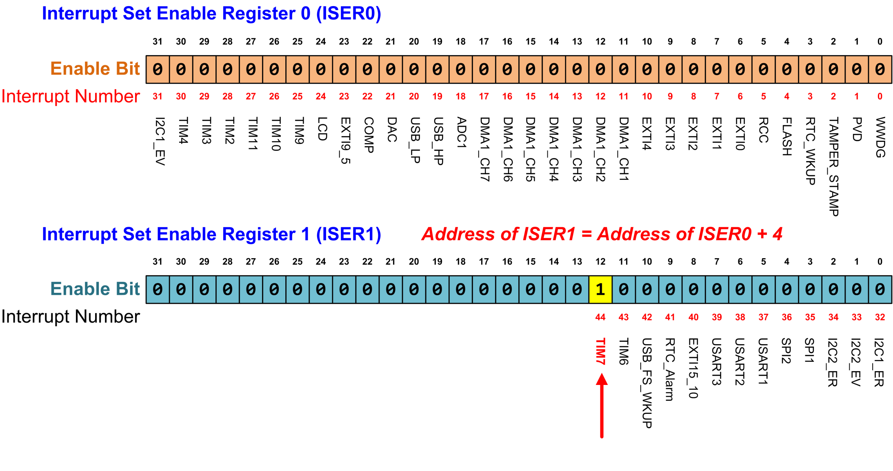
Enabling Peripheral Interrupts
TIM7_IRQn = 44
NVIC->ISER[1] = 1 << 12; // Enable Timer 7 interrupt
Notes:
{{Pause=2}}We can enable a peripheral interrupt by writing 1 to the corresponding bit of the ISER register. {{Pause=0.5}} ISER stands for interrupt set enable register. For example, we will show how to enable the interrupt Timer 7.
The interrupt number of Timer 7 is 44 for STM 32 L1 processor. ISER0 enables interrupts 0 to 31. ISER1 enables interrupts 32 to 63. To enable interrupt 44, we need to set bit 12 of ISER1 to 1.
Note that, write 0 to a bit in a ISER register does not disable the corresponding interrupt.

Slide 47
Explanations of Previous Slide
We can enable a peripheral interrupt by writing 1 to the corresponding bit of the ISER register.
To enable interrupt “Timer 7” with interrupt number 44:
ISER0 controls interrupts 0 to 31; ISER1 controls interrupts 32 to 63.
To enable interrupt 44, we set bit 12 (44-32) of ISER1 to 1 (other bits to 0) by executing ISER[1] = 1 << 12.
Setting a bit to 1 in ISER automatically clears the corresponding bit in ICER (sets it to 0)
Clearing a bit in ISER by writing to it has no effect

Slide 48
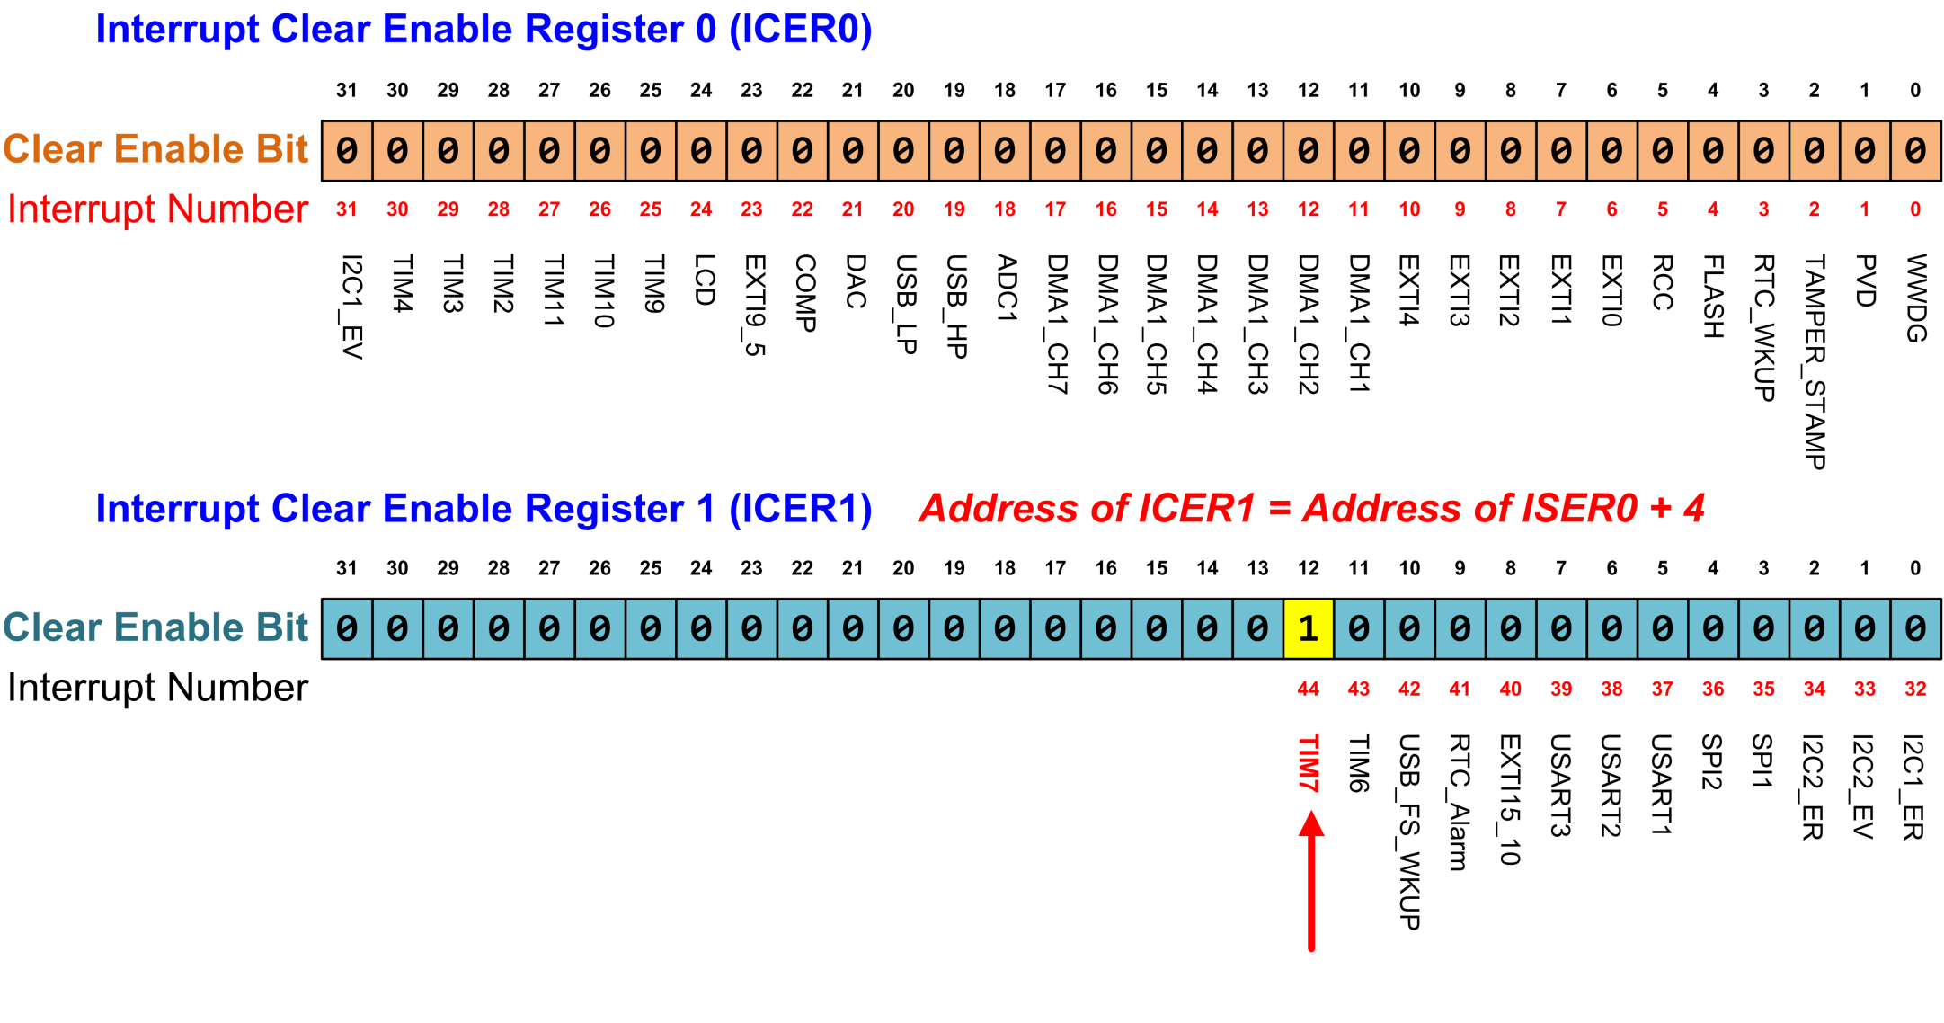
Disabling Peripheral Interrupts
TIM7_IRQn = 44
NVIC->ICER[1] = 1 << 12; // Diable Timer 7 interrupt
Notes:
{{Pause=2}}Similarly, we can disable a peripheral interrupt by writing 1 to the corresponding bit of the ICER register. {{Pause=0.5}} ICER stands for the interrupt set disable register.
The interrupt number of Timer 7 is 44. To enable interrupt 44, we need to set bit 12 of ICER1 to 1. {{Pause=0.5}} Note that writing 1 to a bit in ICER disables the corresponding interrupt. Writing 0 to ICER has no impacts.
Separating enable bits and disable bits in two separate sets of registers, ICER and ISER, provides great convenience for software programmers. It allows us to enable or disable an interrupt flexibly, without worrying about writing zero to the other bits in the target register.

Slide 49
Explanations of Previous Slide
We can disable a peripheral interrupt by writing 1 to the corresponding bit of the ICER register.
To disable interrupt “Timer 7” with interrupt number 44:
ISER0 controls interrupts 0 to 31; ISER1 controls interrupts 32 to 63.
To disable interrupt 44, we set bit 12 (44-32) of ICER1 to 1 (other bits to 0) by executing ICER[1] = 1 << 12.
Setting a bit to 1 in ICER automatically clears the corresponding bit in ISER (sets it to 0)
Clearing a bit in ICER by writing to it has no effect
Separating enable bits and disable bits in two separate sets of registers, ICER and ISER, provides great convenience and flexibility for programmers
Notes:
, without worrying about writing zero to the other bits in the target register

Slide 50
Disable/Enable Peripheral Interrupts
For all peripheral interrupts: IRQn ≥ 0
Method 1: use functions
NVIC_EnableIRQ (IRQn); // Enable interrupt
NVIC_DisableIRQ (IRQn); // Disable interrupt
Method 2: directly set the bit in ISER/ICER
Enable:
NVIC->ISER[ IRQn / 32] = 1 << (IRQn % 32);
Divide IRQn by 32 to find out in which ISER register the target enable bit is located; The bit offset within the target ISER register is determined by the result of IRQn mod 32.
More efficient solution:
NVIC->ISER[ IRQn >> 5] = 1 << (IRQn & 0x1F);
IRQn>>5 == IRQn/32; IRQn & 0x1F == IRQn%32
Disable:
NVIC->ICER[ IRQn >> 5] = 1 << (IRQn & 0x1F);
Notes:
{{Pause=2}} In this slide, we will summarize how to enable or disable a peripheral interrupt. As discussed previously, the interrupt number of all peripherals is larger than or equal to zero.
There are two approaches to enable or disable a peripheral interrupt.
In the first approach, we can use the NVIC Enable and Disable functions. These two functions are provided in the ARM Cortex core header file.
In the second approach, we can directly set the corresponding bit in the ISER or ICER register.
To enable a given peripheral interrupt IRQn, we can divide it by 32 to find out in which ISER register the target enable bit is located. This is because each ISER register has 32 bits. Thus, each ISER register can enable 32 interrupts. The bit offset within the target ISER register is determined by the result of IRQn mod 32.
A better solution is to use the shift and bit-wise logic & operation, instead of the division and modulus operations. This new approach tends to run faster.
Similarly, we can directly set the corresponding bit in the target ICER register to disable interrupt IRQn.

Slide 51
Interrupt Priority
Inverse Relationship:
Lower priority value means higher importance.
Priority of Interrupt A = 5,
Priority of Interrupt B = 2,
B has a higher importance than A.
Priorities are pre-defined for Reset, HardFault, and NMI.
Other interrupts have priority ≥0, adjustable by software.
Exception | IRQn | Priority
Reset | N/A | -3 (the highest)
Non-maskable Interrupt (NMI) | -14 | -2 (2nd highest)
Hard Fault | -13 | -1
Notes:
{{Pause=2}}What should the processor do if multiple interrupts arrive at the same time? ARM processors allow software to set priority levels for almost every interrupt. Accordingly, interrupts that needs to be responded more urgently than others, will be serviced quickly.
For ARM Cortex processors, numerically low priority values are used to specify logically high interrupt priorities. In other words, a lower priority value represents a higher urgency. This is very counterintuitive.
For example, if the priority value of interrupt A is 5, and the priority value of interrupt B is 2, then B has a higher urgency than A. Therefore, the processor will service B first if interrupt A and B arrive at the same time.
The priority of some interrupts are fixed. Specifically, the priority of three system exceptions, including reset, non-masktable interrupt (NMI), and hard fault, are fixed. Their priority levels are negative, and they have the highest urgency.
The priority level of all the other interrupts are adjustable.

Slide 52
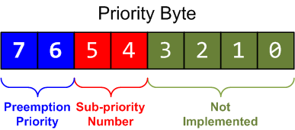
Interrupt Priority
Interrupt priority is configured by Interrupt Priority Register (IP)
Each priority consists of two fields, including preempt priority number and sub-priority number.
The preempt priority number defines the priority for preemption.
The sub-priority number determines the order when multiple interrupts are pending with the same preempt priority number.
Notes:
{{Pause=2}}ARM Cortex-M processors use a byte to represent the priority level. Therefore, it allows a maximum of 256 different priority levels, ranging from priority 0 to priority 255. However, the total number of available priority levels depends on the manufacturer.
For example, STM 32 L4 processors implement four priority bits, which are placed as the most significant bits of the priority byte. Therefore, the N V I C module of STM 32 L4 supports up to 16 interrupt priority levels for peripherals.
In addition, the priority bits are divided into two parts, including preempt priority and sub priority. By default, the preempt priority has the upper two bits, and the sub-priority has the lower two bits. However, the number of bits assigned to each part is configurable.
The preempt priority defines whether an interrupt can preempt an already executing interrupt. In other words, preempt priority determines if one interrupt can preempt another.
The sub priority determines which interrupt will be handled first, when two interrupts of the same preempt priority arrive at the same time. That is to say, the sub priority is used, only when two interrupts with the same preempt priority value are pending. Specifically, the interrupt with the lower sub priority value will be handled first.

Slide 53
Interrupt Priority
NVIC_SetPriority(7, 6);
core_cm4.h or core_cm3.h
typedef struct {
...
// Interrupt Priority Register
volatile uint8_t IP[240];
...
} NVIC_Type;
0 | 1 | 1 | 0 | 0 | 0 | 0 | 0
IP = 0x60
The priority is stored in the most significant 4 bits of the interrupt priority byte. NVIC_SetPriority (7, 6) sets the priority byte of interrupt 7 to 0x60=01100000 in binary. It is equivalent to:
NVIC->IP[7] = 6 << 4;
Notes:
{{Pause=2}} Again, the priority is stored as the most significant four bits of the interrupt priority byte. For example, the statement NVIC Set Priority (7, 6) will set the priority byte of interrupt 7 to 01100000 in binary, or 96 in decimal.
In the NVIC data structure, the interrupt priority registers are mapped to a byte array. Each register holds four priority bytes. The NVIC Set Priority statement is equivalent to the following C statement. First, we shifts left, the priority value four bits, and then store the result in the corresponding interrupt priority byte.

Slide 54
Preemption and Sub-priority Configuration
NVIC_SetPriorityGrouping(n)
Can configure the number of bits in the preemption priority field and the sub-priority field
n | # of bits in preemption priority | # of bits in sub-priority
0 | 0 | 4
1 | 1 | 3
2 (default) | 2 | 2
3 | 3 | 1
4 | 4 | 0
Default
n = 2
Notes:
{{Pause=2}}. Within an interrupt priority byte, the number of bits in the preemption priority field and the sub-priority field can be configured by software.
For STM 32 L4 processors, there are two bits in each field. However, we can use the function NVIC Set Priority Grouping to change the size of each field. This function will change the A I R C R, register, after performing a sequence of unlocking process. A I R C R, stands for Application Interrupt and Reset Control Register.
For example, if the input n is 4, we set all 4 bits to the preemption priority. As result, the preemption priority has a total of 16 priority levels.

Slide 55
Masking Priority
We have discussed enabling/disabling individual interrupts by setting NVIC registers. ARM also provides mechanisms to enable/disable a group of interrupts.
3 Interrupt Mask Registers:
Register Name | Description
PRIMASK | A 1-bit register. When this is set, it allows Reset, NMI and Hard Fault; all other interrupts and exceptions are disabled (masked); default is 0 (no masking)
FAULTMASK | A 1-bit register. When this is set, it allows only Reset and NMI; all other interrupts and exceptions (including Hard Fault) are disabled; default is 0 (no masking)
BASEPRI | A register of up to 9 bits. It defines the masking priority level. When this is set, it disables all interrupts of the same or lower importance (same or larger priority values)
Notes:
{{Pause=2}}In embedded systems, we often have to perform some critical operations, in which data should not be corrupted by other interrupts. Therefore, we need to disable all interrupts with less urgency to ensure that the execution of the critical code will not be interrupts by other interrupts.
We can use the Base Priority Mask Register(BASEPRI) to achieve the protection of critical code. In this example, we disable all interrupts with a priority value of 5 or higher. After executing the critical code, we can remove the interrupt masking by resetting the BASEPRI register to zero.

Slide 56
Masking Priority
The MRS and MSR instructions are used to access the PRIMASK, FAULTMASK, and BASEPRI registers. Examples:
MRS R0, PRIMASK ; Read PRIMASK register into R0
MOV R0, #1
MSR PRIMASK, R0 ; Write R0=1 into PRIMASK register. (Cannot directly ; write #1 to special register with MSR)
MOV R0, #0x60
MSR BASEPRI, R0 ; Write R0= 0x60 into BASEPRI register. (Cannot directly ; write #0x60 to special register with MSR)
Convenience functions can also be used, which calls MRS/MSR within them:
__get_BASEPRI, __set_BASEPRI, __get_PRIMASK, __set_PRIMASK,
__get_FAULTMASK, __set_FAULTMASK
These mask registers can only be set at the Privileged Level.
Notes:
{{Pause=2}}In embedded systems, we often have to perform some critical operations, in which data should not be corrupted by other interrupts. Therefore, we need to disable all interrupts with less urgency to ensure that the execution of the critical code will not be interrupts by other interrupts.
We can use the Base Priority Mask Register(BASEPRI) to achieve the protection of critical code. In this example, we disable all interrupts with a priority value of 5 or higher. After executing the critical code, we can remove the interrupt masking by resetting the BASEPRI register to zero.
PRIMASK and BASEPRI are useful for temporarily disabling interrupts in timing-critical tasks; FAULTMASK is used by the OS kernel which cleans up a crashed task

Slide 57
An Example of either a single interrupt or 2 nested interrupts

Slide 58
Interrupt Service Routine (ISR)
0x20000068
stack
0x0800030C
void EXTI3_IRQHandler{
...
}
0x00000064
0x0800030D
...
0x00000008
0x00000004
0x2000020D
Initialize PC
0x00000000
0x20000068
Initialize SP
Memory
address
Memory
content
Notes:
{{Pause=2}} Here is the interrupt vector table of STM32L4. {{Pause=0.5}} The first word holds the top of the main stack. {{Pause=0.5}} The next 15 words hold the pointers of 15 system exception handlers. {{Pause=0.5}} The next are pointers to vender-specific interrupt handlers. The size of the interrupt vector table, varies among different processor chips.

Slide 59
Single Interrupt
0x20000068
SP
xxxxxxxx
stack
Program
EXTI3
time
0x0800030C
void EXTI3_IRQHandler{
...
}
EXTI3
Interrupt Number
12 | 11 | 10 | 9 | 8
0x00000064
0x0800030D
...
Enable Register
0 | 0 | 0 | 1 | 0
Active Register
0 | 0 | 0 | 0 | 0
0x00000008
0x00000004
0x2000020D
Initialize PC
Pending Register
0 | 0 | 0 | 0 | 0
0x00000000
0x20000068
Initialize SP
Memory
address
Memory
content
Priority Register
3 | 4 | 7 | 2 | 8
Notes:
{{Pause=2}} Let’s use an example to see how N V I C handles an interrupt. Suppose external interrupt 3 (E X T I 3), arrives at this time instant. Assume software has already enabled E X T I 3 interrupt. An interrupt can be enabled by setting the corresponding bit in the interrupt enable register. {{Pause=0.5}} The interrupt number of E X T I 3 is pre-defined as 9. As you see from the interrupt enable register, external interrupt 3 has already been enabled. The interrupt priority register shows that, the priority of external interrupt 3, is set to 2.

Slide 60
Single Interrupt
0x20000068
Stacking
SP
xxxxxxxx
stack
Program
time
0x0800030C
void EXTI3_IRQHandler{
...
}
EXTI3
Interrupt Number
12 | 11 | 10 | 9 | 8
0x00000064
0x0800030D
...
Enable Register
0 | 0 | 0 | 1 | 0
Active Register
0 | 0 | 0 | 0 | 0
0x00000008
1
0x00000004
0x2000020D
Initialize PC
Pending Register
0 | 0 | 0 |  | 0
0x00000000
0x20000068
Initialize SP
Memory
address
Memory
content
Priority Register
3 | 4 | 7 | 2 | 8
Notes:
{{Pause=1}} N V I C first writes 1 to the pending bit of, external interrupt 3, in the interrupt pending register. Let’s assume the floating-point unit (FPU) has not been used in this example. Then, N V I C automatically starts to the stacking process, and pushes, eight registers to preserve the running environment. If the floating-point unit is used, more registers are pushed into the stack during the stacking.

Slide 61
Single Interrupt: after stacking
0x20000068
Stacking
xxxxxxxx | SP + 0x20
xPSR | SP + 0x1C
PC(r15) | SP + 0x18
LR(r14) | SP + 0x14
r12 | SP + 0x10
r3 | SP + 0x0C
r2 | SP + 0x08
r1 | SP + 0x04
r0 | SP
stack
Full Descending Stack
Program
time
0x0800030C
SP
void EXTI3_IRQHandler{
...
}
EXTI3
Interrupt Number
12 | 11 | 10 | 9 | 8
0x00000064
0x0800030D
...
Enable Register
0 | 0 | 0 | 1 | 0
Active Register
0 | 0 | 0 | 0 | 0
0x00000008
1
0x00000004
0x2000020D
Initialize PC
Pending Register
0 | 0 | 0 |  | 0
0x00000000
0x20000068
Initialize SP
Memory
address
Memory
content
Priority Register
3 | 4 | 7 | 2 | 8
Notes:
Note that, ARM Cortex uses full descending stacks. If a 32-bit item is pushed onto the stack, the stack pointer (SP) is decremented by four. After N V I C pushes these eight registers onto the stack, the size of the stack increases by 32 bytes, and the stack pointer is decremented by 32. This stacking process is automatically performed by the N V I C controller, not by the user code.

Slide 62
Single Interrupt
0x20000068
Stacking
xxxxxxxx | SP + 0x20
xPSR | SP + 0x1C
PC(r15) | SP + 0x18
LR(r14) | SP + 0x14
r12 | SP + 0x10
r3 | SP + 0x0C
r2 | SP + 0x08
r1 | SP + 0x04
r0 | SP
stack
ISR 9
Full Descending Stack
Program
time
0x0800030C
SP
void EXTI3_IRQHandler{
...
}
EXTI3
Interrupt Number
12 | 11 | 10 | 9 | 8
0x00000064
0x0800030D
...
Enable Register
0 | 0 | 0 | 1 | 0
Active Register
1
0 | 0 | 0 |  | 0
0x00000008
0
0x00000004
0x2000020D
Initialize PC
Pending Register
0 | 0 | 0 |  | 0
0x00000000
0x20000068
Initialize SP
Memory
address
Memory
content
Priority Register
3 | 4 | 7 | 2 | 8
Notes:
{{Pause=1}} Then, N V I C looks up the interrupt vector table, and finds the starting address of the interrupt service routine for external interrupt 3. {{Pause=1}} Next, N V I C changes the status of interrupt 9, from the pending state, to the active state. {{Pause=1}} After that, N V I C forces the processor to branch to the interrupt handler, and starts to execute the interrupt handler.

Slide 63
Single Interrupt
0x20000068
Stacking
xxxxxxxx | SP + 0x20
xPSR | SP + 0x1C
PC(r15) | SP + 0x18
LR(r14) | SP + 0x14
r12 | SP + 0x10
r3 | SP + 0x0C
r2 | SP + 0x08
r1 | SP + 0x04
r0 | SP
stack
ISR 9
Full Descending Stack
Program
BX LR
time
0x0800030C
SP
void EXTI3_IRQHandler{
...
}
EXTI3
Interrupt Number
12 | 11 | 10 | 9 | 8
0x00000064
0x0800030D
...
Enable Register
0 | 0 | 0 | 1 | 0
Active Register
1
0 | 0 | 0 |  | 0
0x00000008
0
0x00000004
0x2000020D
Initialize PC
Pending Register
0 | 0 | 0 |  | 0
0x00000000
0x20000068
Initialize SP
Memory
address
Memory
content
Priority Register
3 | 4 | 7 | 2 | 8
Notes:
{{Pause=1}} The interrupt service routine, completes its execution, by running the following instruction: {{Pause=0.3}} BX LR.

Slide 64
Single Interrupt
0x20000068
Stacking
Unstacking
xxxxxxxx | SP + 0x20
xPSR | SP + 0x1C
PC(r15) | SP + 0x18
LR(r14) | SP + 0x14
r12 | SP + 0x10
r3 | SP + 0x0C
r2 | SP + 0x08
r1 | SP + 0x04
r0 | SP
stack
ISR 9
Full Descending Stack
Program
BX LR
time
0x0800030C
SP
void EXTI3_IRQHandler{
...
}
EXTI3
Interrupt Number
12 | 11 | 10 | 9 | 8
0x00000064
0x0800030D
...
Enable Register
0 | 0 | 0 | 1 | 0
Active Register
0
0 | 0 | 0 |  | 0
0x00000008
0x00000004
0x2000020D
Initialize PC
Pending Register
0 | 0 | 0 | 0 | 0
0x00000000
0x20000068
Initialize SP
Memory
address
Memory
content
Priority Register
3 | 4 | 7 | 2 | 8
Notes:
{{Pause=1}} The instruction, BX LR, informs the N V I C controller to perform an {{Pause=0.1}} unstacking process. At the same time, the active bit, in the interrupt active register, is cleared. {{Pause=1}} The unstacking process, automatically pops the values of these eight registers, out of the stack. Therefore, N V I C recovers, the processor’s state, or called running environment, to the time instant immediately before the interrupt handler starts.

Slide 65
Single Interrupt: after unstacking
0x20000068
Stacking
Unstacking
SP
xxxxxxxx
stack
ISR 9
Program
BX LR
time
0x0800030C
void EXTI3_IRQHandler{
...
}
EXTI3
Interrupt Number
12 | 11 | 10 | 9 | 8
0x00000064
0x0800030D
...
Enable Register
0 | 0 | 0 | 1 | 0
Active Register
0
0 | 0 | 0 |  | 0
0x00000008
0x00000004
0x2000020D
Initialize PC
Pending Register
0 | 0 | 0 | 0 | 0
0x00000000
0x20000068
Initialize SP
Memory
address
Memory
content
Priority Register
3 | 4 | 7 | 2 | 8
Notes:
After unstacking completes, the running environment has been fully recovered from the stack. All registers have their original values, as if the interrupt has never happened.

Slide 66
Single Interrupt
0x20000068
Stacking
Unstacking
SP
xxxxxxxx
stack
ISR 9
Program
Program
BX LR
time
0x0800030C
void EXTI3_IRQHandler{
...
}
EXTI3
Interrupt Number
12 | 11 | 10 | 9 | 8
0x00000064
0x0800030D
...
Enable Register
0 | 0 | 0 | 1 | 0
Active Register
0 | 0 | 0 | 0 | 0
0x00000008
0x00000004
0x2000020D
Initialize PC
Pending Register
0 | 0 | 0 | 0 | 0
0x00000000
0x20000068
Initialize SP
Memory
address
Memory
content
Priority Register
3 | 4 | 7 | 2 | 8
Notes:
As result, the processor can successfully continue to execute the user program, which has been interrupted by the external interrupt 3.

Slide 67
Nested Interrupts: Example of Preemption
SP
xxxxxxxx
Program
EXTI3
time
External Interrupt 3 (EXTI3) arrives. It has priority=5.
DMA1_Channel2
EXTI3
Interrupt Number
12 | 11 | 10 | 9 | 8
Enable Register
1 | 0 | 0 | 1 | 0
Active Register
0 | 0 | 0 | 0 | 0
Pending Register
0 | 0 | 0 | 0 | 0
Priority Register
3 | 4 | 7 | 5 | 3
Notes:
{{Pause=2}} Let’s see how the N V I C controller handles multiple interrupts. Suppose interrupt request 9 (E X T I 3) arrives at this time instant.

Slide 68
Nested Interrupts: Example of Preemption
xxxxxxxx
xPSR
PC(r15)
LR(r14)
r12
r3
r2
r1
r0
Stacking
ISR 9
Program
EXTI3
time
SP
ISR 9 that serves EXTI3 starts execution after stacking operation.
DMA1_Channel2
EXTI3
Interrupt Number
12 | 11 | 10 | 9 | 8
Enable Register
1 | 0 | 0 | 1 | 0
Active Register
1
0 | 0 | 0 |  | 0
Pending Register
0 | 0 | 0 | 0 | 0
Priority Register
3 | 4 | 7 | 5 | 3
Notes:
{{Pause=2}} N V I C first performs stacking, and pushes these eight registers onto the stack. {{Pause=1}} Then, N V I C forces the processor to execute the interrupt service routine for interrupt 9.

Slide 69
Nested Interrupts: Example of Preemption
xxxxxxxx
xPSR
PC(r15)
LR(r14)
r12
r3
r2
r1
r0
Stacking
ISR 9
Program
EXTI3
DMA1_Channel2
time
SP
Suppose another interrupt request (DMA1_Channel2) arrives, before ISR 9 completes; this new interrupt has higher importance (priority=3) than the current interrupt being served (EXTI3 priority=5). Hence the CPU will respond to the new interrupt by preempting the currently executing ISR 9 that serves EXTI3. EXT3 → ISR 9
DMA1_Channel2 → ISR 12
DMA1_Channel2
EXTI3
Interrupt Number
12 | 11 | 10 | 9 | 8
Enable Register
1 | 0 | 0 | 1 | 0
Active Register
1
0 | 0 | 0 |  | 0
Pending Register
1
 | 0 | 0 | 0 | 0
Priority Register
3
5
 | 4 | 7 |  | 3
Lower priority value means higher importance.
Notes:
{{Pause=2}} Suppose another interrupt request (DMA 1 Channel 2) arrives, before the interrupt service routine 9 completes. In addition, this new coming interrupt, has a higher urgency, than the current interrupt being served. {{Pause=1}} As you see from this table, the interrupt priority value is 3 for interrupt 12, and 5 for interrupt 9. Note that, for ARM Cortex processors, a lower priority value actually represents a higher urgency. Accordingly, N V I C has to respond to the new coming interrupt.

Slide 70
Nested Interrupts: Example of Preemption
Stacking
xxxxxxxx
xPSR
PC(r15)
LR(r14)
r12
r3
r2
r1
r0
xPSR
PC(r15)
LR(r14)
r12
r3
r2
r1
r0
Stacking
ISR 12
ISR 9
Program
EXTI3
DMA1_Channel2
time
The stacking operation for ISR 12 that serves the new interrupt DMA1_Channel2 pushes another set of 8 registers onto the MSP. Note that these two sets of registers have different values. The first set holds register values, for the user program; the second set holds register values for ISR 9. Afterwards, ISR 12 starts execution.
EXTI3
DMA1_Channel2
Interrupt Number
12 | 11 | 10 | 9 | 8
Enable Register
1 | 0 | 0 | 1 | 0
Active Register
1
1
 | 0 | 0 |  | 0
Pending Register
0 | 0 | 0 | 0 | 0
SP
Priority Register
3 | 4 | 7 | 5 | 3
Notes:
{{Pause=2}} Because the new interrupt has a higher urgency, N V I C then stops the current interrupt service routine, and performs another stacking. Again, it pushes another set of eight registers, onto the stack. Note that these two sets of registers have different values. The first set holds register values, for the user program. {{Pause=0.5}} The second set hold register values, for the interrupt service routine 9. {{Pause=1}} After the stacking, N V I C starts to execute, the interrupt service routine of the new coming interrupt. The process of stopping the current interrupt handler, and starting to serve another interrupt, is called interrupt preemption.

Slide 71
Nested Interrupts: Example of Preemption
Stacking
Unstacking
xxxxxxxx
xPSR
PC(r15)
LR(r14)
r12
r3
r2
r1
r0
Stacking
ISR 12
ISR 9
Program
EXTI3
DMA1_Channel2
time
SP
After ISR12 completes, unstacking operation is performed, and ISR 9 resumes execution.
EXTI3
DMA1_Channel2
Interrupt Number
12 | 11 | 10 | 9 | 8
Enable Register
1 | 0 | 0 | 1 | 0
Active Register
0
1
 | 0 | 0 |  | 0
Pending Register
0 | 0 | 0 | 0 | 0
Priority Register
3 | 4 | 7 | 5 | 3
Notes:
{{Pause=2}} After the interrupt service routine 12 completes, N V I C performs unstacking, pops out eight registers from the stack, and recovers the running environment, for the interrupt service routine 9.

Slide 72
Nested Interrupts: Example of Preemption
Stacking
Unstacking
xxxxxxxx
xPSR
PC(r15)
LR(r14)
r12
r3
r2
r1
r0
Stacking
ISR 12
ISR 9
ISR 9
Program
EXTI3
DMA1_Channel2
time
SP
DMA1_Channel2
EXTI3
Interrupt Number
12 | 11 | 10 | 9 | 8
Enable Register
1 | 0 | 0 | 1 | 0
Active Register
1
0 | 0 | 0 |  | 0
Pending Register
0 | 0 | 0 | 0 | 0
Priority Register
3 | 4 | 7 | 5 | 3
Notes:
Then, N V I C continues the execution of interrupt service routine 9.

Slide 73
Nested Interrupts: Example of Preemption
Stacking
Unstacking
SP
xxxxxxxx
Stacking
ISR 12
Unstacking
ISR 9
ISR 9
Program
Program
EXTI3
DMA1_Channel2
time
After ISR9 completes, unstacking operation is performed, and the user program resumes execution.
EXTI3
DMA1_Channel2
Interrupt Number
12 | 11 | 10 | 9 | 8
Enable Register
1 | 0 | 0 | 1 | 0
Active Register
0
0 | 0 | 0 |  | 0
Pending Register
0 | 0 | 0 | 0 | 0
Priority Register
3 | 4 | 7 | 5 | 3
Notes:
{{Pause=2}} After the interrupt service routine 9 completes, N V I C performs un-stacking to recover the running environment of the user program. After unstacking, the user program resumes the computation.

Slide 74
Nested Interrupts: Tail Chaining
In the previous example, we have shown that, an interrupt with higher importance can preempt another interrupt with lower importance.
Suppose interrupt EXTI4 has lower importance than EXTI3. If EXTI4 arrives before the ISR 9 that serves EXTI3 completes, then it will wait in pending state until ISR 9 completes execution.
EXTI3 → ISR 9; EXTI4 → ISR 10
The stacking/unstacking operations when ISR 9 finishes and ISR 10 starts immediately are unnecessary. Tail chaining is used to reduce latency of context switching between two ISRs, by omitting stacking/unstacking operations.
Typically the stacking/unstacking operation takes12 cycles each, while tail chaining takes only 6 cycles.
12 cycles
12 cycles
Unstacking
Stacking
Unstacking
1
Stacking
ISR 9
ISR 10
Program
Program
EXTI3
EXTI4
time
Stacking
Tail Chaining
Unstacking
ISR 9
ISR 10
Program
6 cycles
Program
EXTI3
EXTI4
time
Notes:
{{Pause=2}} In the previous example, we have shown that, an interrupt with higher urgency, can preempt, an interrupt with relatively lower urgency. What would happen if the new coming interrupt request has a lower urgency? {{Pause=1}} Suppose external interrupt 4 has less urgency than exernal interrupt 3. If external interrupt 4 arrives, before the external interrupt 3 Handler completes, N V I C won’t respond the new coming interrupt request. Instead, N V I C will continue the execution of the current interrupt service routine. After the current interrupt service routine completes, unstacking and stacking are performed, before the new interrupt service routine starts.
{{Pause=1}} As you notice, the middle unstacking and stacking processes are unnecessary in this example. Therefore, ARM Cortex-M deploys an optimization technique, called tail chaining, to reduce the interrupt latency. Typically the unstacking process takes 12 cycles. The stacking takes 12 cycles too. However, the tail chaining takes only 6 cycles.

